Slide 1

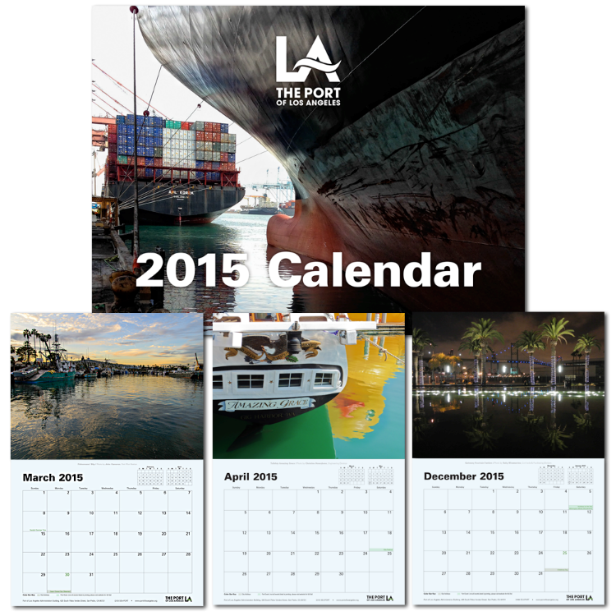
Port of
Los Angeles
2015 Port of Los Angeles Wall Calendar
Promotional/Advocacy Materials

